Slide 1

Nrega analysis by power bi
Kholod sadek

Slide 2
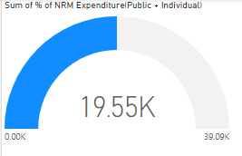
● How effective is NREGA in providing employment opportunities to rural households?

Slide 3
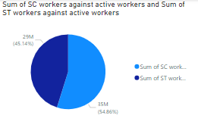
● Are there regional disparities in the implementation and outcomes of the scheme?

Slide 4
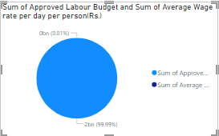
What is the utilization of the allocated budget, and how does it correlate with employment generation?

Slide 5
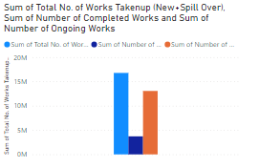
● What are the key factors contributing to the completion of NREGA works, and are there any roadblocks to its success?

Slide 6
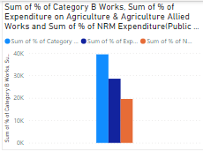
● Can data-driven insights guide policymakers and administrators in optimizing the scheme's impact?

Slide 7

Thank You

